Slide 1
LIDA Abstract and Vector Frameworks
Presented by
Sean Kugele
Saturday, March 22, 2014

Slide 2
Current Framework
Specific to single data structure
“Linkables” (Nodes, Links, NodeStructures)
Many framework modules (e.g., PAM, Workspace), support classes (e.g., ElementFactory, GUI panels), and configuration files are specific to these data structures
Approx. 70 of the 194 classes are data structure specific

Slide 3
How do we support arbitrary data structures?

Slide 4
Abstract Framework
Separate interfaces from implementations
Logic indifferent to a specific data structure will reside in the Abstract Framework
Logic specific to a data structure is separated into a “child” framework

Slide 5
Abstract Framework
NodeStructure Framework
Vector Framework
Future Framework?
…

Slide 6
Refactoring the Framework
New interfaces from common data structures
New interfaces for framework modules
Linkables (Links/Nodes) | CognitiveContent
NodeStructure | CognitiveContentStructure

Slide 7
Refactoring the Framework
New factories and factory XML configuration
StrategyFactory and FrameworkTaskFactory are in the “Abstract Framework”
Factory for creating subclasses of CognitiveContent is in child frameworks
Create child frameworks (NodeStructure, Vector, etc.)

Slide 8
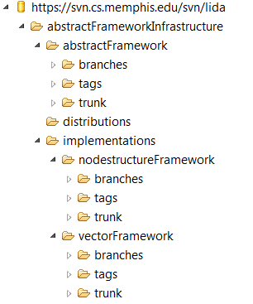
SVN Repository Structure

Slide 9
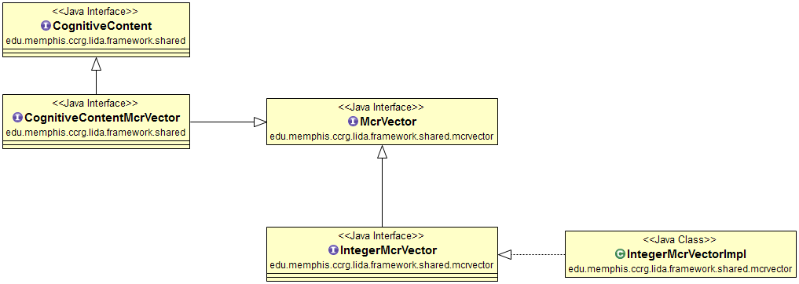
Vector Framework
A MCR (Modular Composite Representation ) Vector specific implementation of the framework
Notes:
CognitiveContent extends Activatible.
CognitiveContentMcrVector decorates McrVector to add Activatible methods.

Slide 10
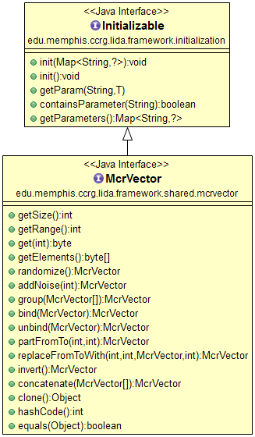
McrVector

